Slide 1
Module 5: Environmental Policies, Laws, Regulations & ethics
Lecture 5.1
Topics covered: Regulation of technology and innovation, Policy and laws, Different Acts such as: Environmental Protection Act, Air and Water Acts, Wildlife and Forest Acts), US-EPA, National Environmental Policy;

Slide 2
Background
The need for protection and conservation of environment and sustainable use of natural resources is reflected in the constitutional framework of India and also in the international commitments of India.
Major thrust for putting in force a well-developed framework came only after the UN Conference on the Human Environment (Stockholm, 1972).
After the Stockholm Conference, the National Council for Environmental Policy and Planning was set up in 1972 within the Department of Science and Technology to establish a regulatory body to look after the environment-related issues., which later evolved into Ministry of Environment and Forests (MoEF).

Slide 3
Important laws and policies for environment protection in India
The Environment Protection Act, 1986
The National Green Tribunal Act, 2010
National Environment Policy, 2006
National Conservation Strategy and Policy Statement on Environment and Development, 1992
The Air (Prevention and Control of Pollution) Act, 1981
The Water (Prevention and Control of Pollution) Act, 1974
The Hazardous Waste Management Regulations.

Slide 4
The Environment Protection Act, 1986
Came into force on May 23, 1986
OBJECTIVES
To prove protection and improvement of Environment
Prevention of hazards to all forms of life including human beings and property
For prevention and control of environmental pollution
Laying standards for environmental quality
Restriction of areas for location of industries
Safeguard for handling hazardous substances
Research related to environmental pollution
https://www.slideshare.net/FarhanAliKhan1/environmental-protection-act-1986-34749524

Slide 5

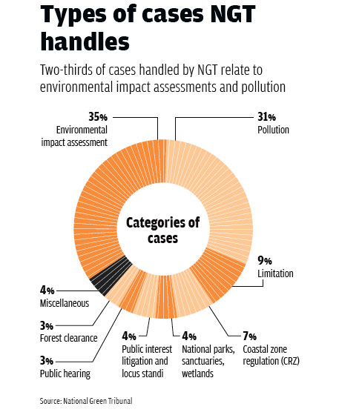
The National Green Tribunal Act, 2010 (No. 19 of 2010) (NGT Act)
Objective for establishment of a National Green Tribunal (NGT) is for the effective and expeditious disposal of cases relating to environment protection and conservation of forests and other natural resources including enforcement of any legal right relating to environment and giving relief and compensation for damages to persons and property and for matters connected therewith or incidental thereto.
The Act received the assent of the President of India on June 2, 2010, and was enforced by the Central Government vide Notification no. S.O. 2569(E) dated October 18, 2010, with effect from October 18, 2010.
https://sabrangindia.in/article/why-modi-govt-needed-curb-independence-green-tribunal-eye-opener
https://www.mondaq.com/india/waste-management/624836/environment-laws-in-india

Slide 6
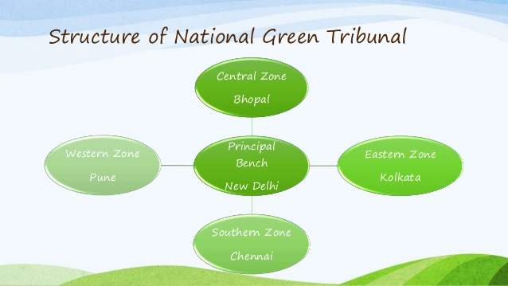
https://www.google.com/url?sa=i&url=https%3A%2F%2Fwww.iasipstnpsc.in%2Fnational-green-tribunal-ngt%2F&psig=AOvVaw1DojcdkPLK8XyZNjXqyqCu&ust=1605879948016000&source=images&cd=vfe&ved=0CAMQjB1qFwoTCIiQ-JDfju0CFQAAAAAdAAAAABAb

Slide 7
National Environment Policy (NEP)- 2006
Formulated in 2006 by Ministry of Environment and Forest,Govt. of India
Aims at mainstreaming environmental concerns into all developmental activities.
The objectives of the policy include:
Conservation of critical environmental resources
Intra-generational equity
Livelihood security for the poor
Inter-generational equity
Integration of environmental concerns in economic and social development
Efficiency in environmental resource use
Environmental governance
Enhancement of resources for environmental conservation
https://www.indiawaterportal.org/articles/national-environment-policy-nep-ministry-environment-and-forests-2006#:~:text=Governance-,National%20Environment%20Policy%20(NEP)%20%2D%20Ministry,of%20Environment%20and%20Forests%20(2006)&text=A%20document%20that%20emphasizes%20on,and%20equity%20of%20natural%20resources.&text=It%20argues%20that%20environmental%20degradation,poor%20health%20outcomes%20among%20populations

Slide 8
National Conservation Strategy and Policy Statement on Environment and Development, 1992
It is in response to the need for laying down the guidelines that will help to weave environmental considerations into the fabric of our national life and of our development process. It is an expression of India’s commitment for reorienting policies and action in unison with the environmental perspective.
It talks about the nature and dimensions of the environmental problems, actions taken in response to the problems and lists out priorities and strategies for action. It also views development policies from environmental perspectives and the support policies and systems required.
http://iced.cag.gov.in/?page_id=1030

Slide 9
The Air (Prevention and Control of Pollution) Act, 1981
It is an act to provide for the prevention, control and abatement of air pollution and for the establishment of Boards at the Central and State levels with a view to carrying out the aforesaid purposes.
Ambient air quality standards were established under the Air Act.
The Act seeks to combat air pollution by prohibiting the use of polluting fuels and substances, as well as by regulating appliances that give rise to air pollution. The Air Act empowers the State Government, after consultation with the SPCBs, to declare any area or areas within the Sate as air pollution control area or areas.
Under the Act, establishing or operating any industrial plant in the pollution control area requires consent from SPCBs. SPCBs are also expected to test the air in air pollution control areas, inspect pollution control equipment, and manufacturing processes.
https://www.mondaq.com/india/waste-management/624836/environment-laws-in-india

Slide 10
The Water (Prevention and Control of Pollution) Act, 1974
The Act has been enacted to provide for the prevention and control of water pollution and to maintain or restore wholesomeness of water in the country.
Provides for the establishment of Boards for the prevention and control of water pollution with a view to carry out the aforesaid purposes.
The Water Act prohibits the discharge of pollutants into water bodies beyond a given standard, and lays down penalties for non-compliance. At the Centre, the Water Act has set up the CPCB which lays down standards for the prevention and control of water pollution. At the State level, SPCBs function under the direction of the CPCB and the State Government.
https://www.mondaq.com/india/waste-management/624836/environment-laws-in-india

Slide 11
The Hazardous Waste Management Regulations
Hazardous Wastes (Management, Handling and Transboundary) Rules, 2008, brought out a guide for manufacture, storage and import of hazardous chemicals and for management of hazardous wastes.
Biomedical Waste (Management and Handling) Rules, 1998, were formulated along parallel lines, for proper disposal, segregation, transport, etc, of infectious wastes.
Municipal Solid Wastes (Management and Handling) Rules, 2000, aim at enabling municipalities to dispose municipal solid waste in a scientific manner.
https://www.mondaq.com/india/waste-management/624836/environment-laws-in-india

Slide 12
The Forest (Conservation) Act, 1980 and The Forest (Conservation) Rules, 1981
The Act states that prior approval of the Central Government is essential for the diversion of forest areas for the non-forestry purposes.
Diversion of forest land is mostly allowed in order to meet developmental needs for drinking water and irrigation projects, transmission lines, railways, roads, power projects, defense related projects, and mining
Compensatory afforestation must take place and plans for catchment area treatment, biodiversity and wildlife conservation, rehabilitation etc. must be submitted to the state authority.
In 2003 new rules were issued to regulate the rights of tribals on forest lands, and guide the process of establishing productive village forests.
https://forestlegality.org/risk-tool/country/india#:~:text=The%20Indian%20Forest%20Act%20of%201927%2C%20the%20country's%20guiding%20forestry,timber%20and%20other%20forest%20produce

Slide 13
The National Forest Policy, 1988
This policy was established to ensure compensatory afforestation, essential environmental safeguards, sustainable utilization, maintenance, restoration, and enhancement of forest areas.
Emphasized that forests should meet the subsistence requirements of people and was intended to decrease degradation by forest dwellers through better management
Its main implementing programme is called Joint Forest Management, which proposed that villages manage specific forest blocks in association with forest departments, in order to provide for the basic needs of rural and tribal populations, increase forest productivity, improve the efficiency of forest product utilization, and minimize the pressure on existing forests.
JFM programmes are currently present in 27 states, represent 85,000 village committees, and cover over 17.3 million hectares of forest area.
https://forestlegality.org/risk-tool/country/india#:~:text=The%20Indian%20Forest%20Act%20of%201927%2C%20the%20country's%20guiding%20forestry,timber%20and%20other%20forest%20produce

Slide 14
Wildlife Protection Act, 1972 and The Wildlife (Protection) Amendment Act, 2006
most important statute providing protection of wildlife.
The Act prohibits hunting of animals listed in Schedule I, II, III & IV. The Act states that hunting or collecting wild animals and plants in areas protected by the State requires approval from the Forestry Administration.
Under the Act, the state government may declare any area of adequate ecological, faunal, floral, natural or zoological importance as a sanctuary or a national park. In both national parks & sanctuaries, public entry is restricted & the destruction of any wildlife or habitat is prohibited. In 1986 the Act was suitably amended.
The 2006 Amendment Act created the National Tiger Conservation Authority and the Tiger and Other Endangered Species Crime Control Bureau (Wildlife Crime Control Bureau).
https://www.lawteacher.net/free-law-essays/international-law/the-indian-forest-and-wildlife-acts-international-law-essay.php

Slide 15
The Biological Diversity Act, 2002
The Biodiversity Act 2002 has been enacted in pursuance of the United Nations Convention on Biological Diversity (UNCBD) in 1992.
Objective of this Act is to “provide for conservation of biological diversity, sustainable use of its components and equitable sharing of the benefits” arising therefrom.
https://www.lawteacher.net/free-law-essays/international-law/the-indian-forest-and-wildlife-acts-international-law-essay.php

Slide 16

United States Environmental Protection Agency (US-EPA)
US-EPA is an independent executive agency of United States federal government that sets and enforces standards related to environmental protection
Protects people and the environment from significant health risks, sponsors and conducts research, and develops and enforces environmental regulations.
In 1970, in response to the welter of confusing, often ineffective environmental protection laws enacted by states and communities, President Richard Nixon created the EPA to fix national guidelines and to monitor and enforce them.
https://www.usa.gov/federal-agencies/environmental-protection-agency

